Slide 1


Mount Sinai Supply Chain Management
Recall Management Reset
December 2023

Slide 2
MD Buyline Recall Oversight
Supply Chain
Specialty Areas
(OR)
Nursing
Clinical Engineering
(equipment)
Corporate
Facility
Department
Procedural Areas
(Cath, EP, IR, etc.)
Risk Management
Materials Management
(product)
Recall Officer
Pharmacy
(pharmaceuticals)

Slide 3
MD Buyline Custom Recall Workflow – Corporate Level

Slide 4
MD Buyline Recall Workflow – Facility Level

Slide 5
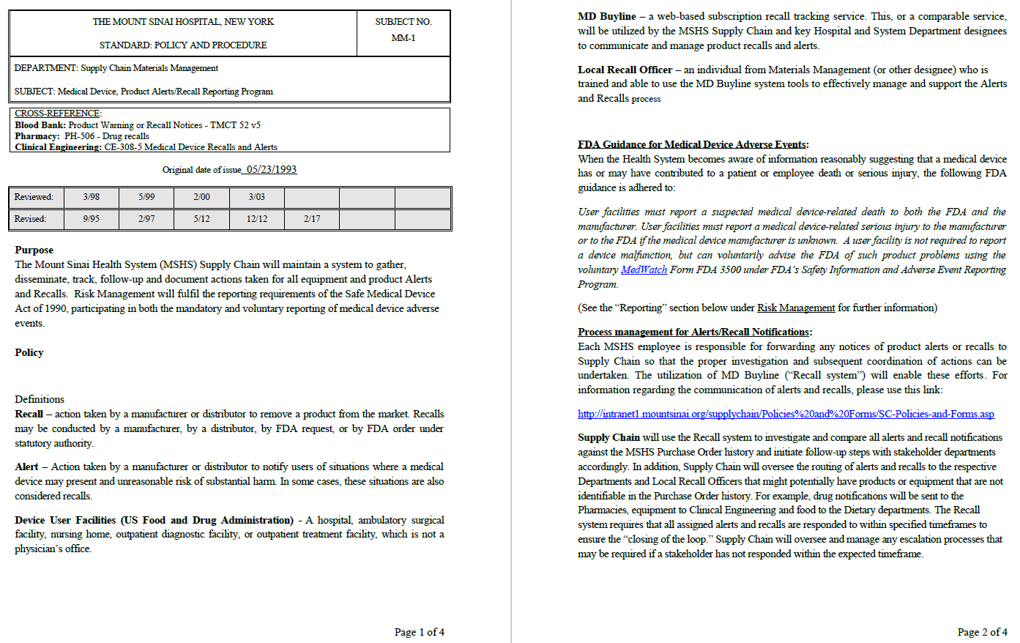
MSHS Recall Policy - pg. 1 & 2

Slide 6
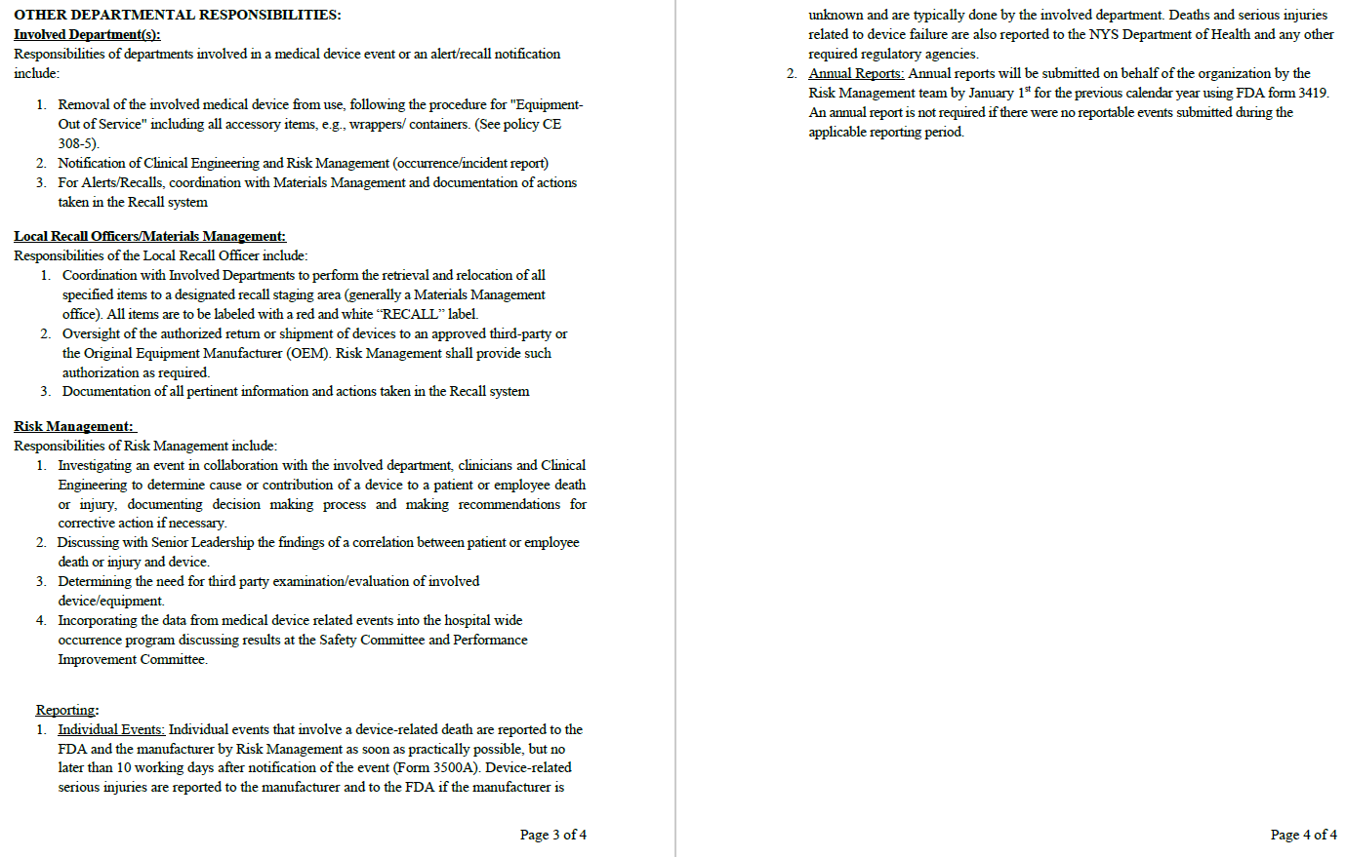
MSHS Recall Policy - pg. 3 & 4

Slide 7
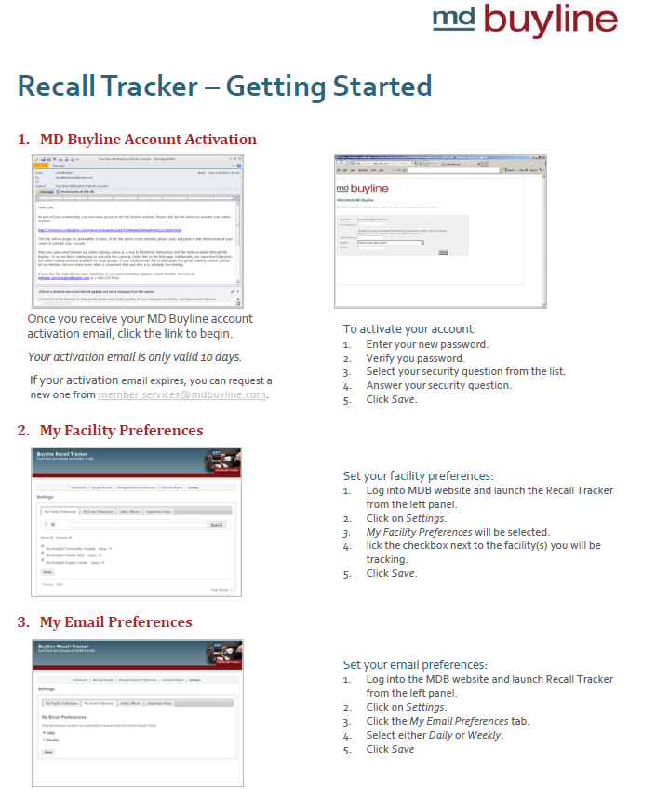
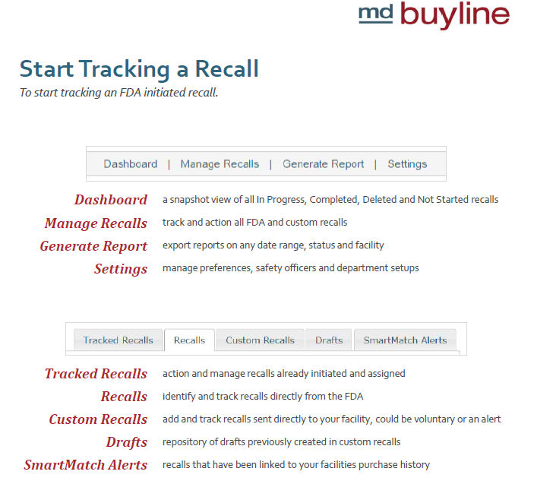
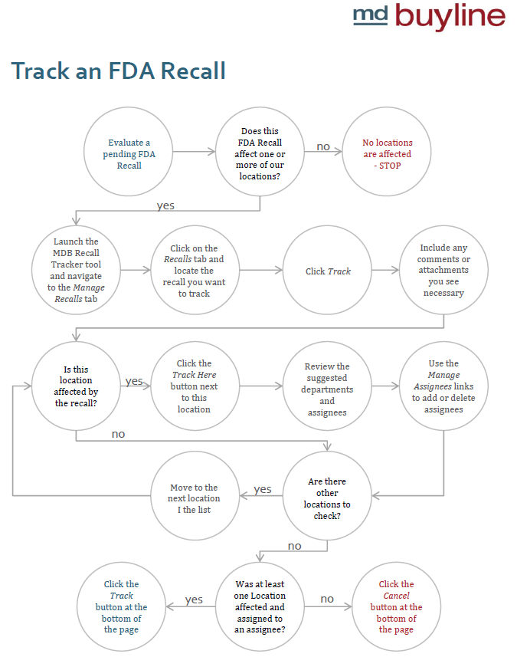
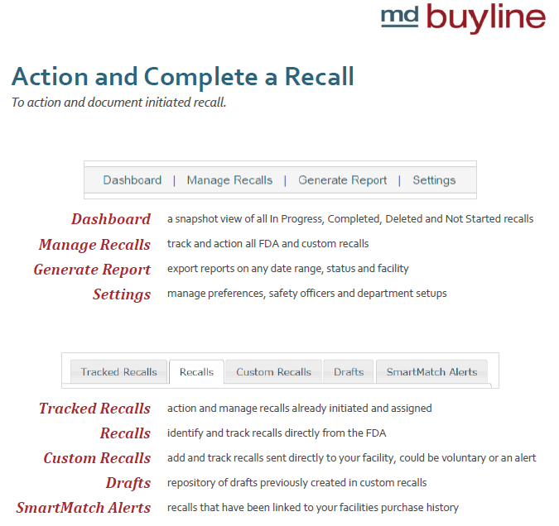
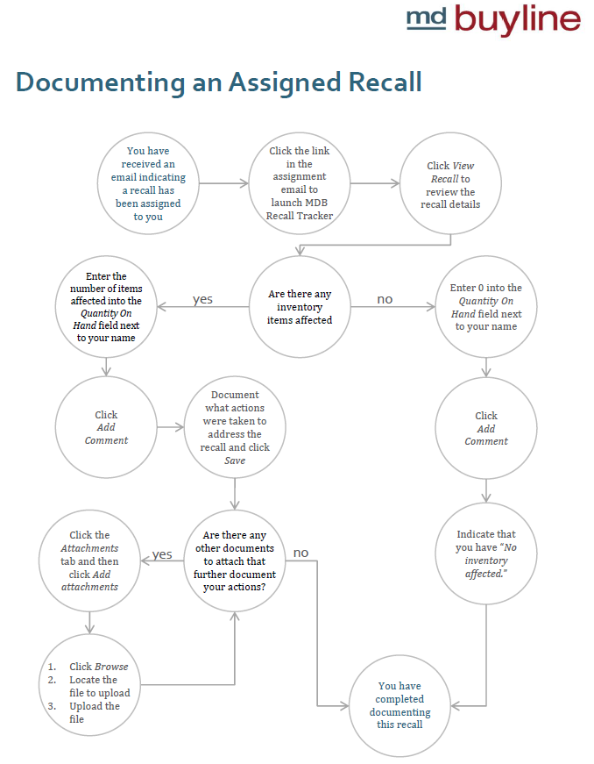
MSHS Recall Training - pgs. 1 to 5

Slide 8
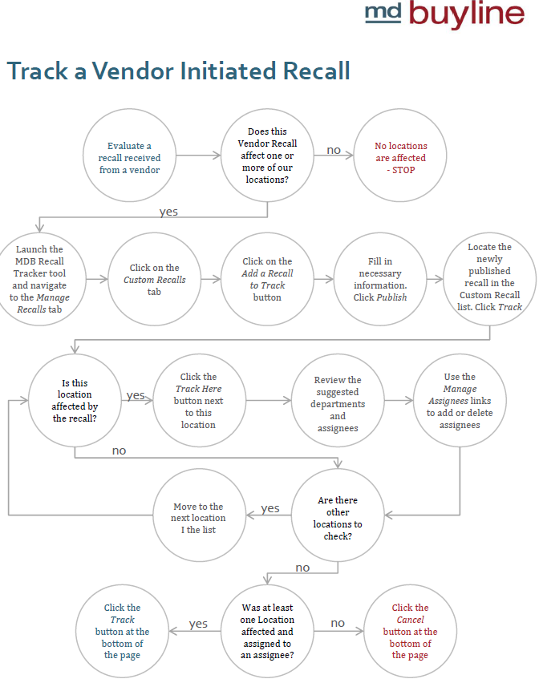
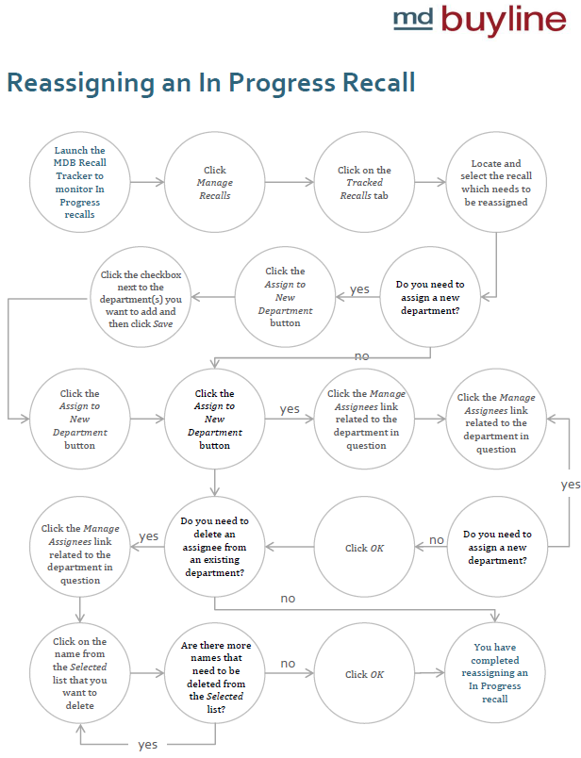
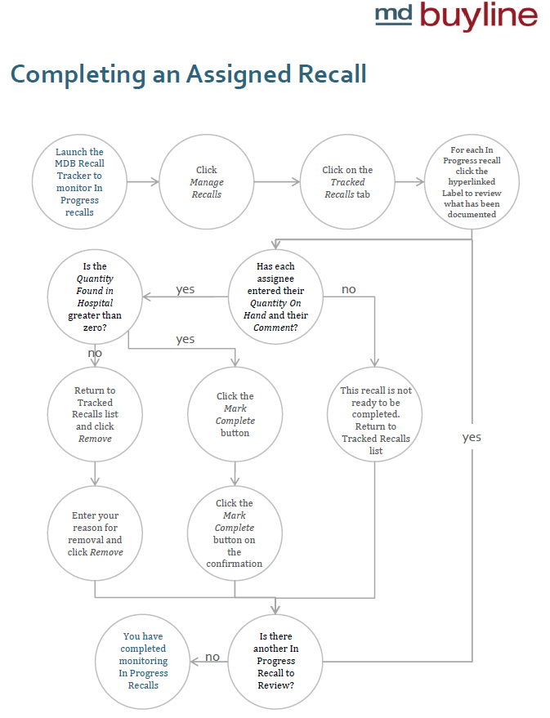
MSHS Recall Training - pgs. 6 to 8

Slide 9
MSHS Recall – Tasks – Phase 1
Amend vendor contracts to include protocol for sending in recall/correction notices to productrecalls@mountsinai.org
Add vendor registration attestation acknowledging understanding the recall protcol
Add to vendor scorecard
Identify corporate supply chain resource to act as Recall Officer/Manager and alternates as back up when Recall Officer is unavailable
Meghal?
Tasha DeGeorge?
MD Buylines to train all involved MSHS personnel on software and process to follow
Materials Directors at each site to act as liaisons and assist recall officer in communicating recalls to end users/departments and assisting with follow up to completion
Weekly/Monthly reconciliation of outstanding recall responses by recall officer
Quarterly presentation of recall completion rate to Risk Management
Smart Match and Custom Recalls
Review recall management policy
Establish recall response time standard – 1 week?
Identify clinical resource (e.g. Nurse Educator) to communicate correction notice information to clinical staff and ensure that any training/in-servicing is completed
Update MD Buyline Distribution List

Slide 10
MSHS Recall – Tasks – Phase 2
Under the direction of the Recall Officer/Manager Materials Directors to complete random audits of stockrooms where recalled items are stocked to ensure that all effect lots have been removed
Create secondary depository for completed recall/correction forms and associated documentation in the event that MD Buyline software is down?

Slide 11
MD Buyline Recall – Reset Plan
Finalize Plan
Review w/Risk Management
Train
Update Configuration
/Distribution
(Extended Team)
Train
Update Configuration
/Distribution
(Materials Teams)
Run Compliance Report

